Slide 1
Preconstruction Collaboration - Bentley ProjectWise
ACEC/NCDOT
Presenter: Bryan Edwards, PE

Slide 2
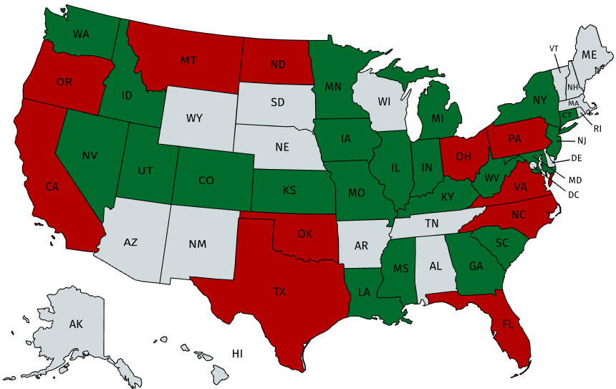
ProjectWise Use Among State DOTs

Slide 3
Preconstruction Collaboration – Future Project Store and SharePoint
ProjectWise Benefits
External partners have controlled access to projects
True Document Management System for CADD
Collaborations Area
Search and Report
NCDOT
(ProjectStore)
NCDOT
SharePoint
(Non CADD)
ProjectWise
(CADD)
SharePoint Benefits
External partners have controlled access to projects
Document management system (for non CADD)
No cumbersome FTS/email for file delivery
NCDOT
External Partners

Slide 4
Important to get it Right !
Delivery of TIP
NCDOT
SharePoint
(Non CADD)
ProjectWise
(CADD)

Slide 5
How does it work?
NCDOT ProjectWise
Access to Cloud
Managed Workspaces
Speed
Reference Files
(read only)
DGN file
(checked-out)
CADD Workspace Standards

Slide 6
How does it work?
NCDOT ProjectWise
User can update server copy
If user leaves town without checking in file, and Admin has to force a check in .. Reverts back to status
Reference Files
(read only)
DGN file
(checked-in)
CADD Workspace Standards

Slide 7
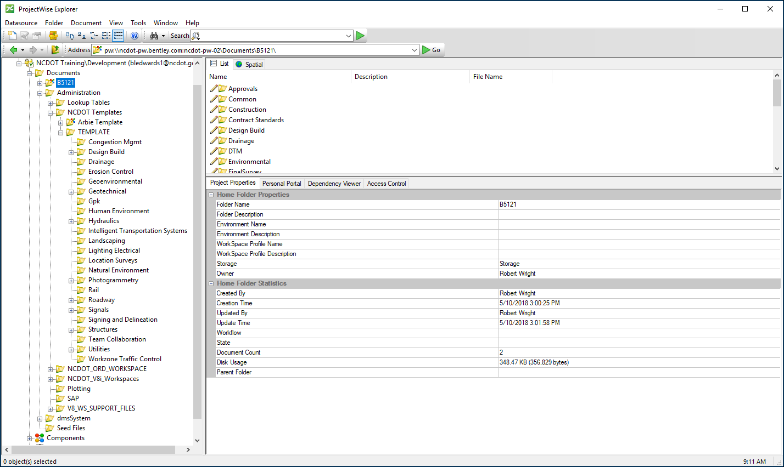
ProjectWise Explorer

Slide 8
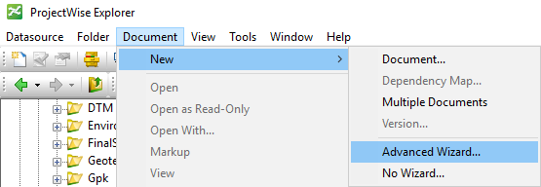
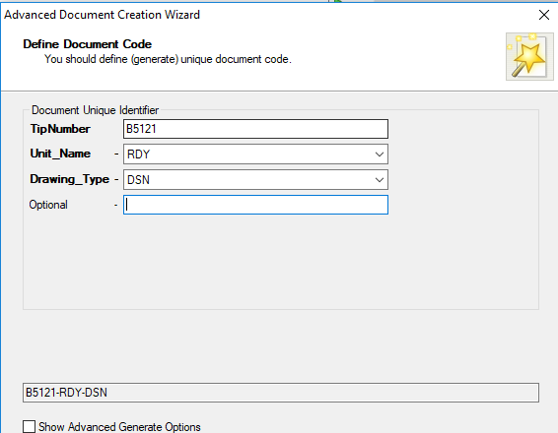
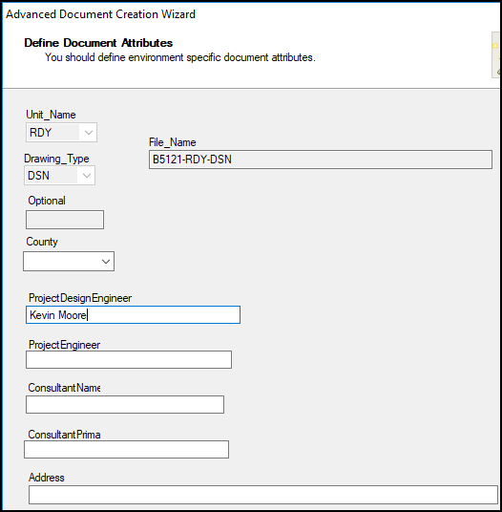
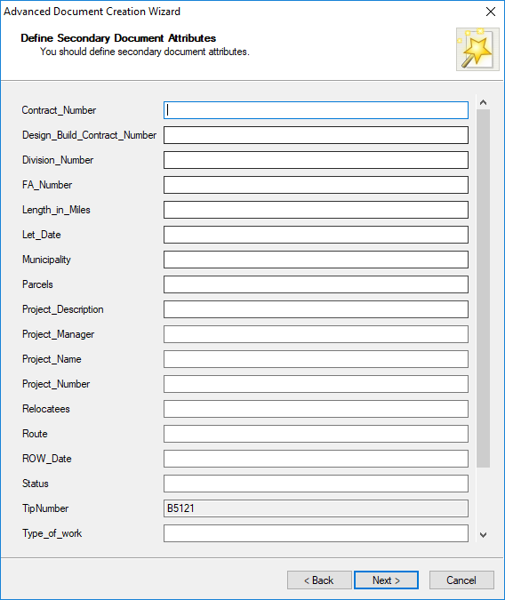
File Creation
CADD Services ProjectWise Meetings
DesignFileGenerator – Functionality Built in to ProjectWise

Slide 9
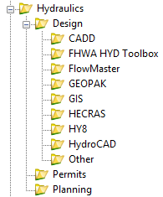
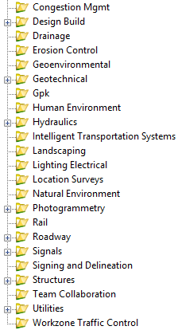
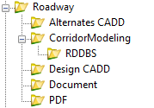
New TIP Folder Structure

Slide 10
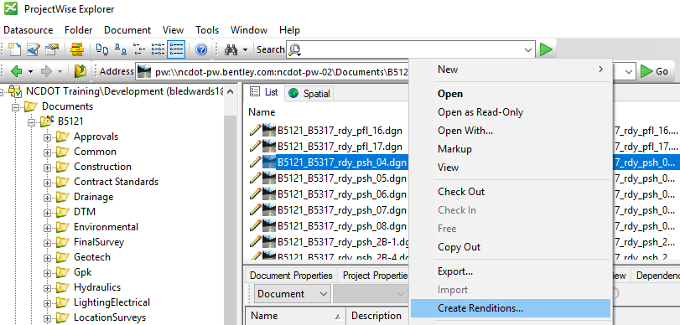
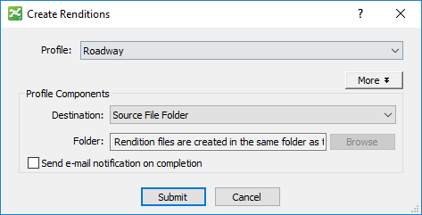
PDF Creation - Renditions
CADD Services ProjectWise Meetings

Slide 11
Metadata Attribution – From SAP

Slide 12
ProjectWise Licensing Options
Passport
($128/yr/person)
Tools
ProjectWise Web Client
Deliverables Management
(More geared for review / not ideal for collaboration)
Visa
($720/yr/person)
Tools
ProjectWise Web Client
(Ideal for collaboration / most larger firms already have this / CADD Workspaces wrapped inside)

Slide 13
ProjectWise Piloting Strategy
Start with 3 Projects – MOVE them from ProjectStore into ProjectWise
Maintain the existing TIP folder structure these projects. (New folder structure for new projects)
Utilize ProjectWise Managed Workspaces
Begin Piloting soon! (Late August/early September)
Changes are anticipated based upon feedback from Piloting. Once changes are made, we will roll out a larger number of projects into ProjectWise (similar to a second piloting phase).
Training materials in the form of documentation and/or videos will be provided for PEFs

Slide 14
NCDOT ProjectWise
Thank You!

